Slide 1
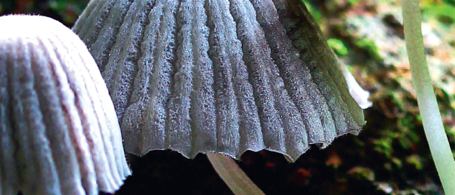
Chapter 4: Energy and matter in ecosystems

Slide 2
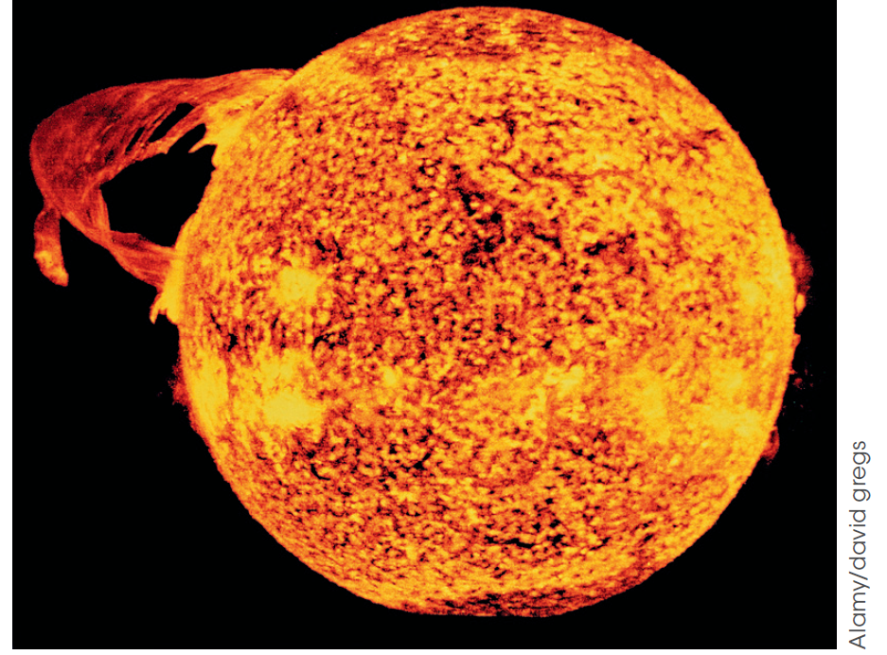
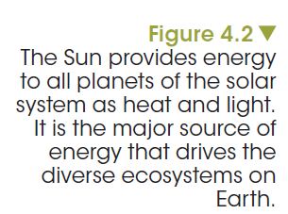
Energy sources for life
The Sun provides energy as radiant energy, visible light, non-visible radiation and heat.
Notes:
The Sun provides most of Earth’s energy in the form of radiant energy. Energy in the form of heat energy warms our planet surface and this in turn warms the atmosphere that drives all of the geochemical processes, tides, weather systems and ocean currents. The amount of energy in sunlight depends on the wavelength of the incoming light. Since the Sun emits visible, infrared and ultraviolet light, the associated energy is very large (Figure 4.2).

Slide 3
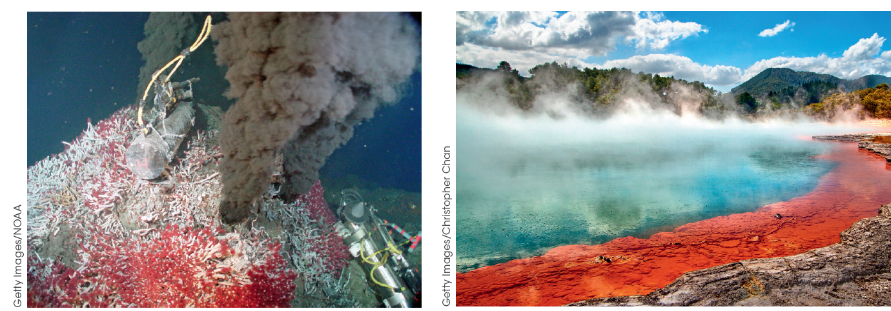
Energy sources for life
Heat from Earth’s core supplies thermal energy to support organisms in regions where conditions are extreme.
Notes:
Other sources of energy include geothermal energy, which is heat generated from Earth’s core. Some of this extreme heat escapes to generate geothermal activity on Earth’s surface and in the ocean. Hydrothermal vents are regions in the deep ocean where volcanic magma heats seawater to more than 300°C. On Earth’s surface, volcanic activity creates extreme environments. For example, the Wai-o-tapu geothermal reserve, near Rotorua in New Zealand, has numerous hot springs and geysers.

Slide 4
How do living organisms use energy?
Autotrophs (producers) transform the Sun’s energy into high energy chemical bonds during the synthesis of organic materials. Autotrophs produce all of the organic matter, or food, for all other organisms in an ecosystem rely on for nourishment.

Slide 5
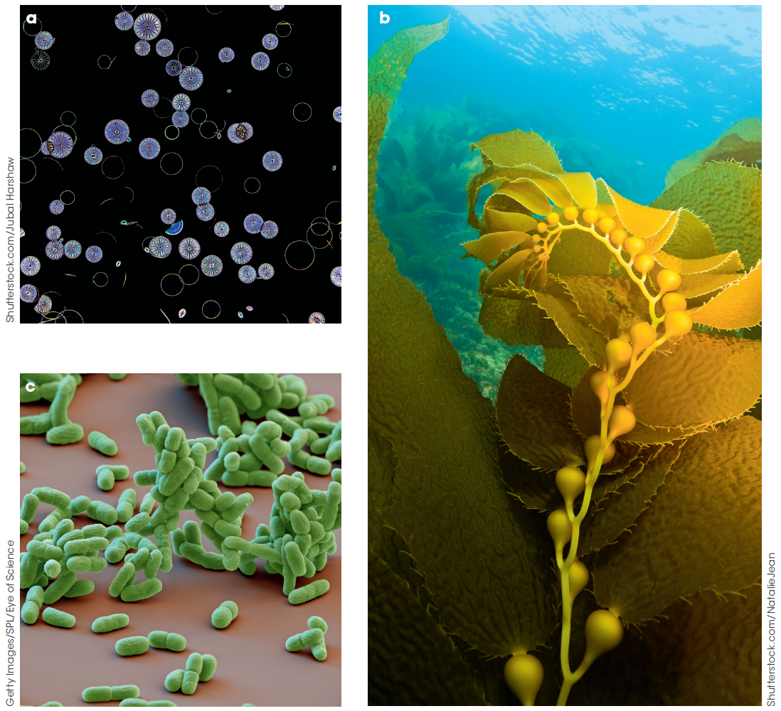
How do producers transform the Sun’s energy?
How do living organisms use energy?
Producers transform sunlight into chemical energy in a biochemical process called photosynthesis.
Figure 4.4
Photosynthetic autotrophs including (a) algae, (b) plants and (c) cyanobacteria transform energy from sunlight and store it as chemical energy in the bonds of glucose.
Notes:
Photosynthetic autotrophs including plants, algae and cyanobacteria transform energy from sunlight and store it as chemical energy in the bonds of glucose.

Slide 6
How do living organisms use energy?
Heterotrophs (consumers) depend on autotrophs directly or indirectly for their energy needs and their supply of matter. Heterotrophs consume other organisms.
Notes:
Consumers include animals, fungi and many kinds of bacteria.

Slide 7
Photosynthetic efficiency
How do living organisms use energy?
Photosynthesis, producers and productivity
How well a producer converts light energy into carbohydrates during photosynthesis.
This depends on the:
amount of light
temperature
availability of raw materials.
Notes:
Not all producers make the same amount of plant mass. How well a producer converts light energy into carbohydrates during photosynthesis is referred to as its photosynthetic efficiency. This depends on the availability of raw materials and sunlight. As temperature influences the rate at which chemical reactions occur, prevailing environmental temperatures can affect this efficiency. Therefore, the production of organic materials from the glucose made in photosynthesis is greater in some seasons compared to others and also varies according to latitude and altitude. For example, tropical forests cover only about 4% of Earth’s surface but contribute about 25% of the world’s yearly gross primary productivity (GPP) of organic matter. Some trees literally grow to extraordinary heights in their competition for light.

Slide 8
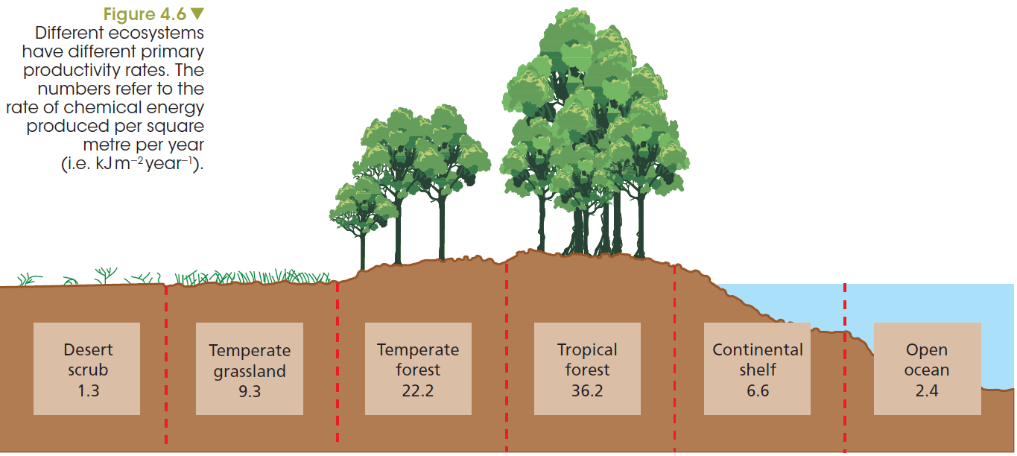
Examples of net primary productivity in different ecosystems
How do living organisms use energy?
Photosynthesis, producers and productivity
Notes:
NPP for an ecosystem can be calculated if we know the amount of biomass in grams over an area in meters squared, in a given time frame, usually a year. It is important to understand that this is a rate of change of biomass over one year and is expressed in the appropriate units as:
● mass: g m⁻² year⁻¹
● energy: kJ m⁻² year⁻¹
What happens to the remaining mass or energy? To answer this question we need to know the energy needs of the organisms together with how matter and energy are passed along from one organism to another in the community occupying the ecosystem.

Slide 9
Consumers obtain matter and energy from producers.
How do living organisms use energy?
Consumers cannot carry out photosynthesis and therefore cannot derive their energy directly from the Sun. Animals of all sizes from insects to elephants must obtain their energy from the food they eat.

Slide 10
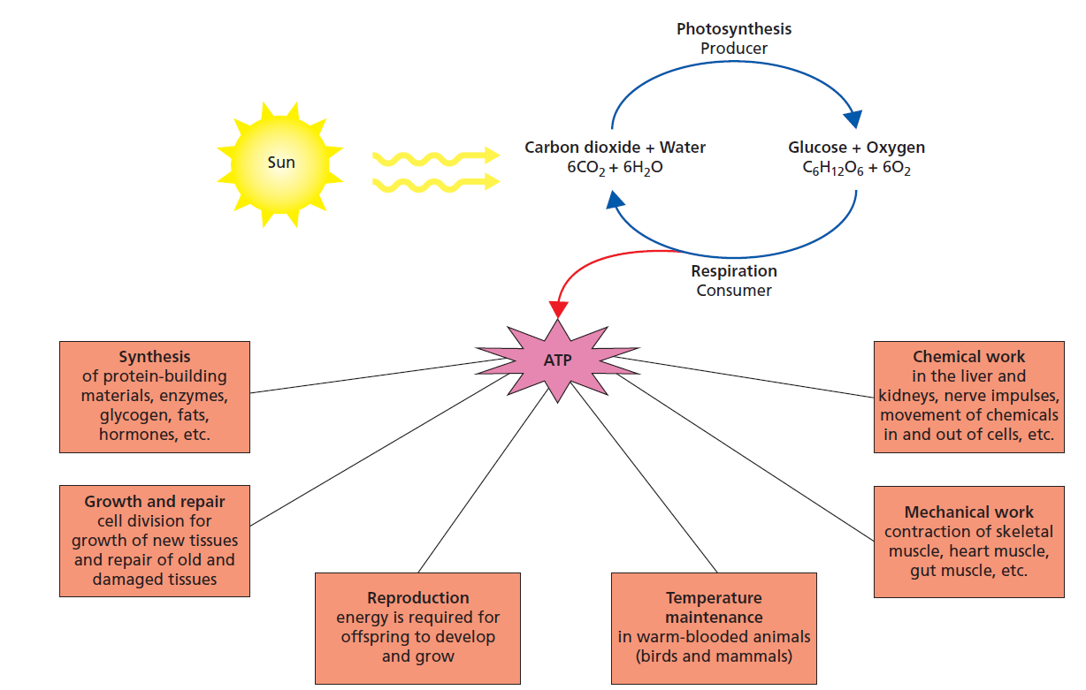
Why is energy so important?
How do living organisms use energy?
Notes:
Energy is required for animals to carry out work. This may include foraging for food, avoiding predators or long treks during the annual migration and, in the case of homoeothermic organisms, for keeping them warm. Some energy is used to keep bodily functions working, building or repairing new tissues and for the production of gametes in reproduction (Figure 4.7).

Slide 11
Ecological systems - IPO
Modelling the ecosystem: transfer of energy and matter
Inputs → Processing → Outputs (+ Storage)
Example: photosynthesis
Inputs → Processing → Outputs
CO_{2 photosynthesis}
water
O₂
glucose
water
Notes:
Scientists study the interactions of complex systems to find out how they are sustained and to predict how they are changed if disruptions occur. A system is a set of interacting components that together form a complex network. We can describe systems using the IPO model.
In photosynthesis, for example, the inputs are water and carbon dioxide and the outputs are oxygen, carbohydrates, water and energy. The energy that drives the process of photosynthesis is sunlight.

Slide 12
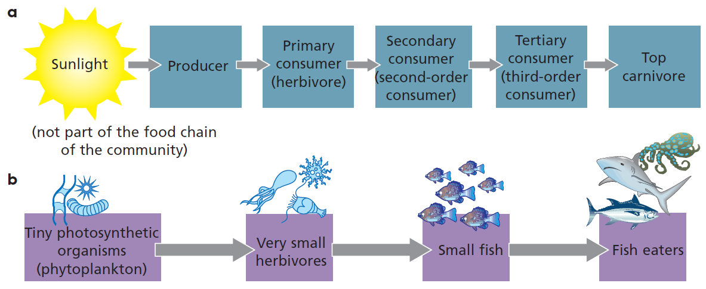
Food chains
Modelling the ecosystem: transfer of energy and matter
Figure 4.8 a) A generalised food chain; b) A food chain in the ocean
Notes:
Animals that feed directly on producers are herbivores or first-order consumers.
Carnivores that depend directly on herbivores are second-order (or secondary) consumers and so on. The top consumers are not preyed upon but, like most of us, die of old age, disease or injury. Animals that feed on the dead remains of other animals are scavengers. Some organisms are both herbivores and carnivores and so are called omnivores.

Slide 13
Energy loss in food chains
Modelling the ecosystem: transfer of energy and matter
The 10% rule in ecology states that only about 10% of the energy at one trophic level is passed on to the next level.
The remaining 90% is lost to the surroundings as heat energy and chemical energy in wastes.
Notes:
Food chain models often have discrepancies between what is predicted from the model and what is actually observed in the field. In the real situation no energy transfer process is completely efficient.
In other words, there will always be losses along the way. Accounting for such discrepancies increases the accuracy of how the model food chain describes the real situation in nature. The percentage of the energy at one trophic level that ends up in the next trophic level is referred to as trophic efficiency.

Slide 14
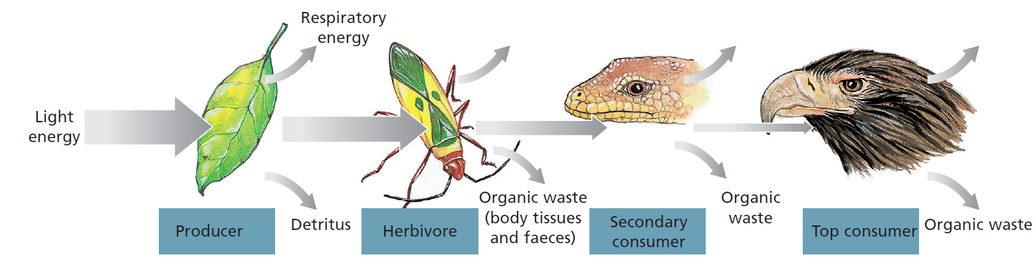
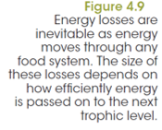
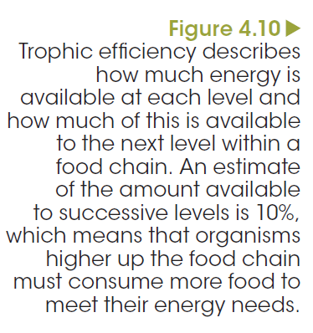
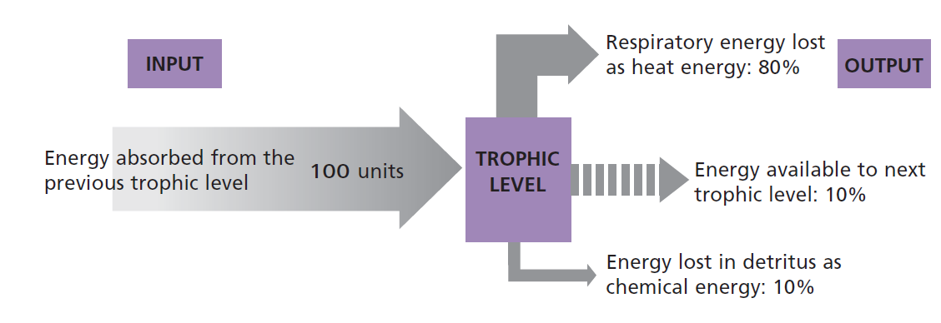
Food chain modelling to measure trophic efficiency
Modelling the ecosystem: transfer of energy and matter
Notes:
Animals differ considerably in how efficiently they use the energy from the food that they eat.
The efficiency of energy transfer from one organism to the next can vary from less than 0.1% to more than 10%. For example, insects do not need to use energy to keep their bodies warm.
Therefore, more of the total energy derived from feeding is available to be passed on. Kangaroos on the other hand must keep warm and use a considerable amount of energy to do this. A higher percentage of energy is passed on from plants to insects to birds than from plants to a kangaroo.
As a result, the loss of energy at each link limits the number of trophic levels a food chain can have (Figures 4.9 and 4.10).

Slide 15
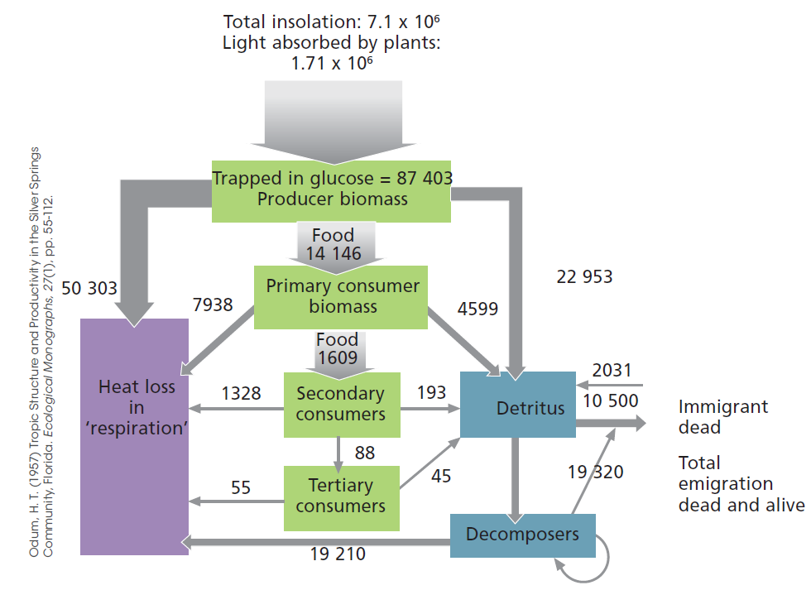
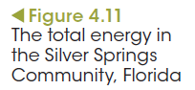
Quantifying trophic efficiency
Modelling the ecosystem: transfer of energy and matter
Notes:
The first study to quantify trophic efficiency was undertaken by H. T. Odum in Florida over a period of 4 years. The results of his work are summarised in Figure 4.11. This model is still used by ecologists to calculate trophic efficiencies of a variety of ecosystems. The units used are kilojoules of energy per square metre per year (kJ m22 y21). As shown in the figure, energy trapped from the Sun and stored by plants as carbohydrates is used up by the 4th trophic level (tertiary consumers) and so this limits the number of links in the chain. In other words, there is not enough energy to support higher trophic levels than the 4th level because energy input equals the total energy output.

Slide 16
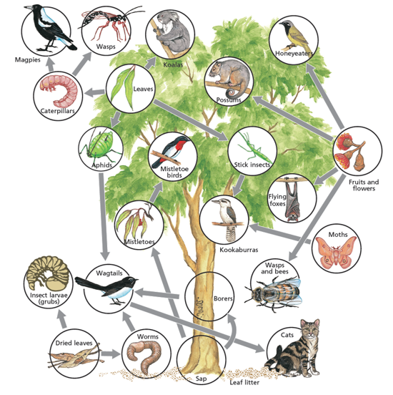
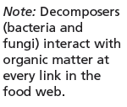
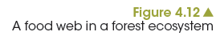
Eat or be eaten: food webs are integrated food chains
Modelling the ecosystem: transfer of energy and matter
Notes:
Omnivore consumers, including humans, can occupy more than one trophic level in the food chain. As primary consumers, humans can obtain more of the available energy from plants directly without losses that occur by eating foods higher up the food chain (Figure 4.12).
Consumption of livestock means that humans can only benefit from 1% of the total available energy from producers. If it is more energy efficient for omnivores to eat plants why is it necessary for them to consume meats and animal products?

Slide 17
Pyramid of numbers
Quantitative modelling to predict change
Ecological pyramids can provide quantitative relationships between trophic levels of a community in terms of:
• numbers of organisms involved
• the biomass (the amount of organic matter)
• the amount of energy transferred from one trophic level to the next.

Slide 18
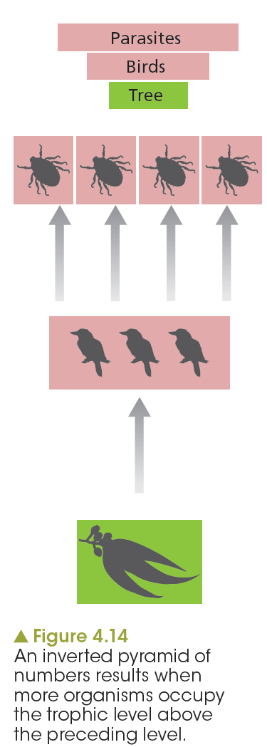
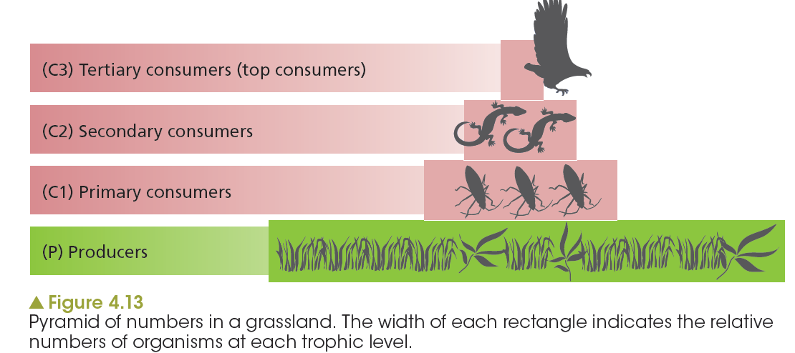
Pyramid of numbers
Quantitative modelling to predict change
Notes:
If we consider a so-called ‘typical’ food chain, there tends to be a progressive drop in the number of organisms found at each level. This is represented as a pyramid of numbers. Figure 4.13 shows the progressive fall in numbers at each trophic level.
Inverted pyramids of numbers can also result when communities contain parasites. Imagine a native mammal, such as a bandicoot or a wallaby, infested with ticks or fleas. These parasites are in the trophic level above these animals, yet their numbers are much greater. An example of an inverted pyramid of numbers is shown in Figure 4.14.

Slide 19
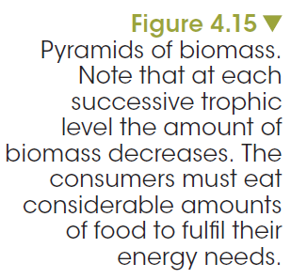
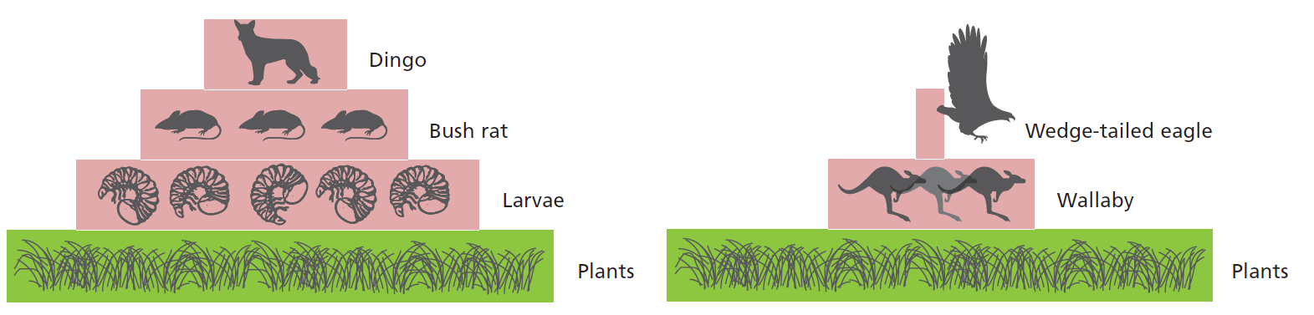
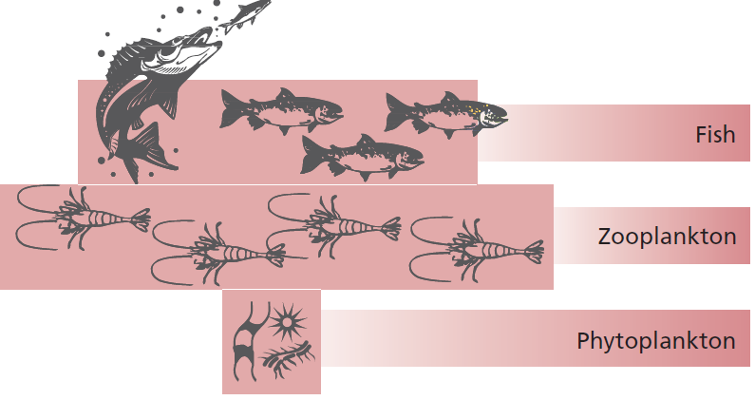
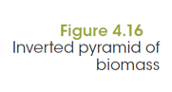
Pyramid of biomass
Quantitative modelling to predict change
Notes:
Whilst the pyramid of numbers is only concerned with the numbers of organisms at each trophic level and their dependence on each other, the pyramid of biomass is another type of ecological pyramid that can be constructed for a community. The total mass (amount of dry organic matter) of organisms at each level is measured. The measurement can be at one particular time or it can be calculated as a rate from measurement of dry mass in a given area for
the duration of a year (e.g. g m⁻² year⁻¹).

Slide 20
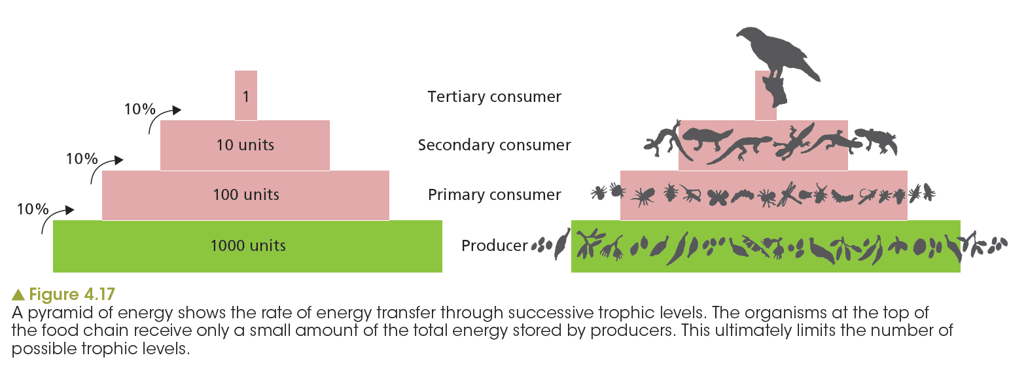
Pyramid of energy
Quantitative modelling to predict change
Notes:
Pyramids of energy are expressed in units of energy per area in a given time, for example, kilojoules per square metre per year (kJ m⁻² y⁻¹). They show the rate at which energy is transferred from one trophic level to another. This dynamic view of a community contrasts with the ‘snap shot’ picture provided if energy is only taken at one particular time point. Pyramids of energy allow ecologists to describe the rate of energy transfer in a community. This allows them to make predictions about whether a community can be sustained or what impact changes to rates of energy transfer will have on the community.
As only some of the energy stored in a trophic level goes to the next trophic level, pyramids of energy can never be inverted in the way that pyramids of numbers or biomass sometimes are.
The higher the trophic efficiency, the steeper the sides of the pyramid will be. This means that a pyramid of energy drawn to show an ocean ecosystem would have steeper sides than one drawn to show a terrestrial ecosystem that is dominated by birds or mammals.

Slide 21
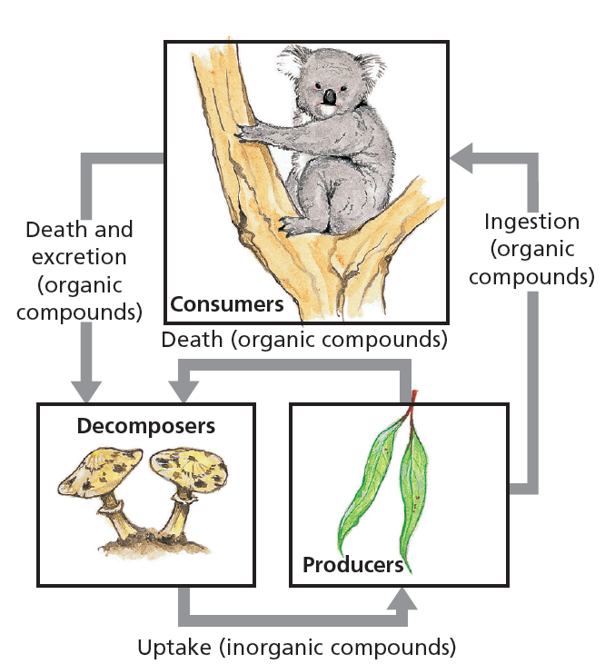
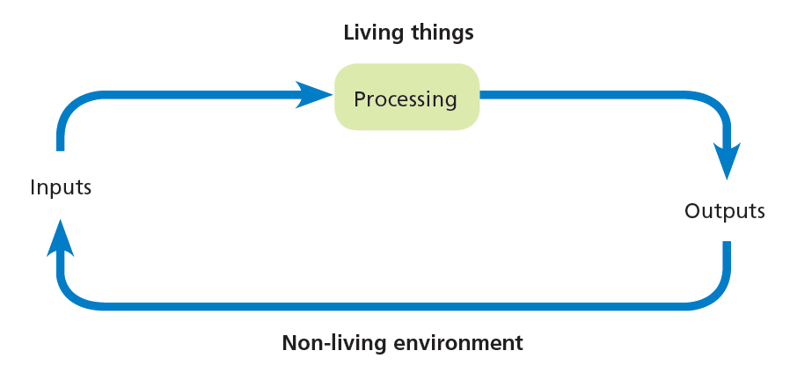
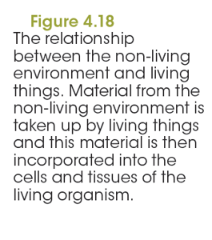
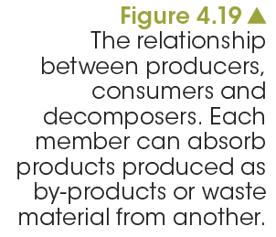
A matter of recycling
Full circle: How does matter get recycled?
Notes:
Matter is cycled between the living (biotic) component and the nonliving (abiotic) components of the ecosystem. We noted earlier that energy is lost along food chains through the production of organic wastes such as faeces and dead tissues. However, the matter comprising this detritus is not necessarily lost to the ecosystem. Detritivores, such as worms, feed on plant detritus and scavengers feed on the dead carcasses of animals. In this way, the organic matter re-enters the food chains.

Slide 22
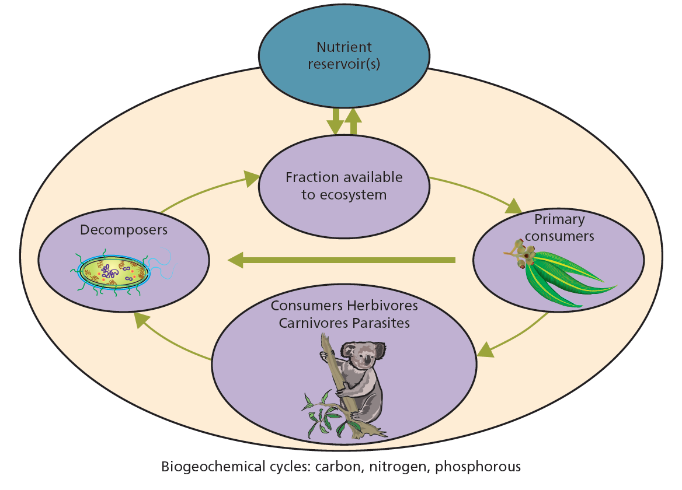

Material cycling models
Full circle: How does matter get recycled?
Notes:
The way in which matter is cycled has a large effect on the availability of these nutrients.
Nutrient cycles feature the following two main components.
1 A biological component that follows how the element cycles through organisms
2 A geochemical component showing how the element cycles through soils and rocks, water and the atmosphere.
Given the interdependent manner in which these components are related, nutrient cycles are also called biogeochemical cycles (Figure 4.20).

Slide 23
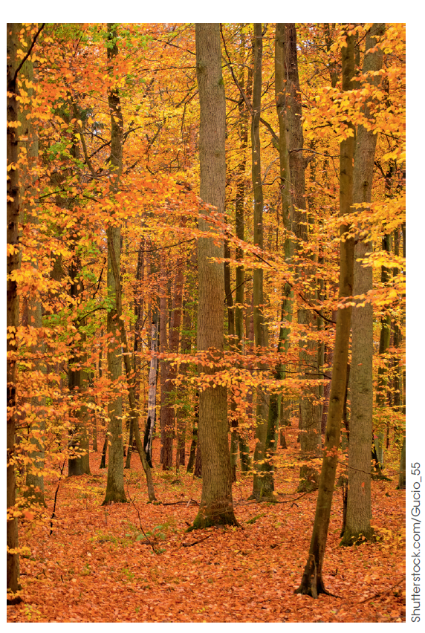
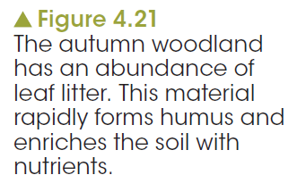
Soil cycling
Full circle: How does matter get recycled?
Notes:
Micro-organisms, fungi and insects present in the soil and on the surface contribute to the decay of plant matter such as leaf litter under trees.
The organic matter in the soil is called humus, which, apart from storing nutrients, contributes to the soil’s texture and water-holding capacity. Soils with little nutrient-storage capacity can easily become depleted with changes or disturbances, such as fire, logging, ploughing, intensive cropping and removal of soil in run-off.

Slide 24
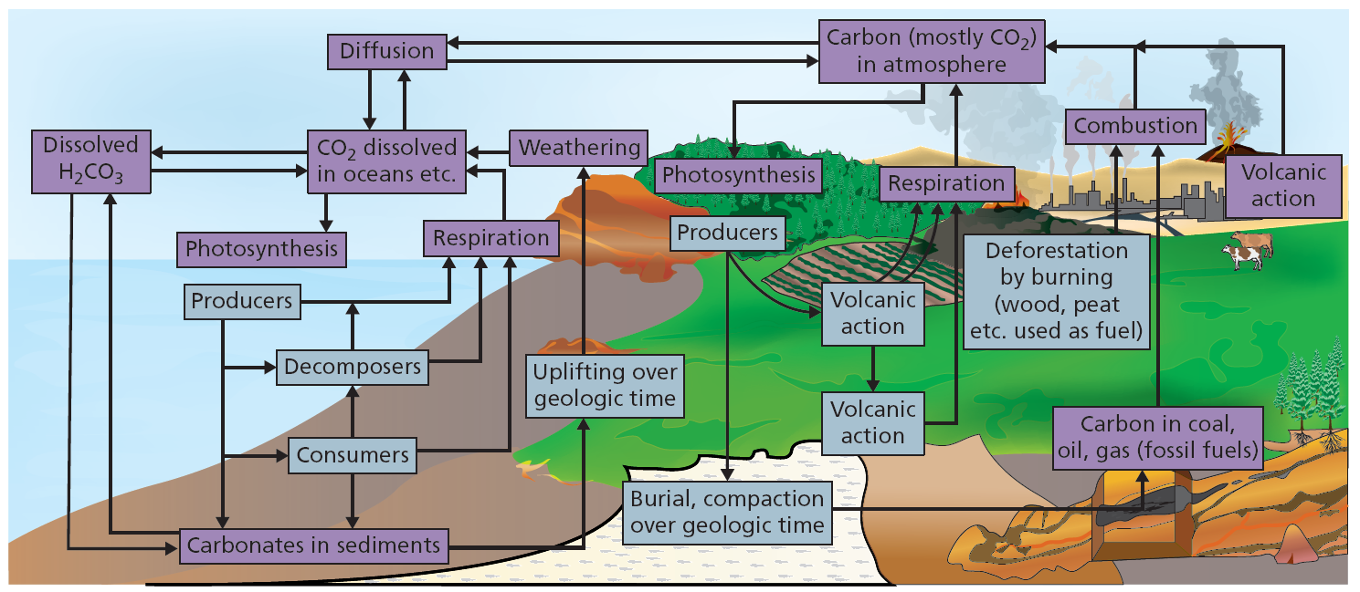
Carbon cycle
Full circle: How does matter get recycled?
Notes:
In the absence of any decomposers, carbon would still be able to circulate for some time within an ecosystem. Not all dead material decays. In anaerobic or highly acidic conditions, decomposers may be unable to break down all the remains and waste products of organisms. In such situations and over long periods of time, these substances may accumulate to form fossil fuels, such as peat, coal, oil and gases derived from them. In nature, these deposits represent a sink, whereas source refers to the origin of materials deposited in the sink.

Slide 25
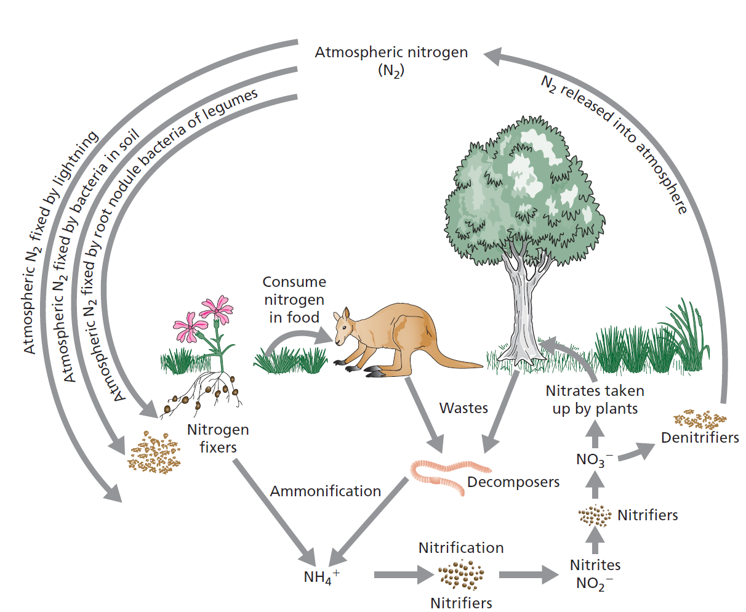
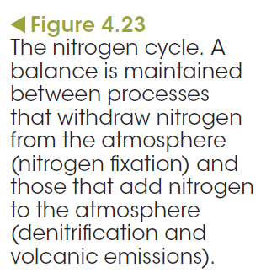
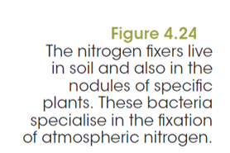
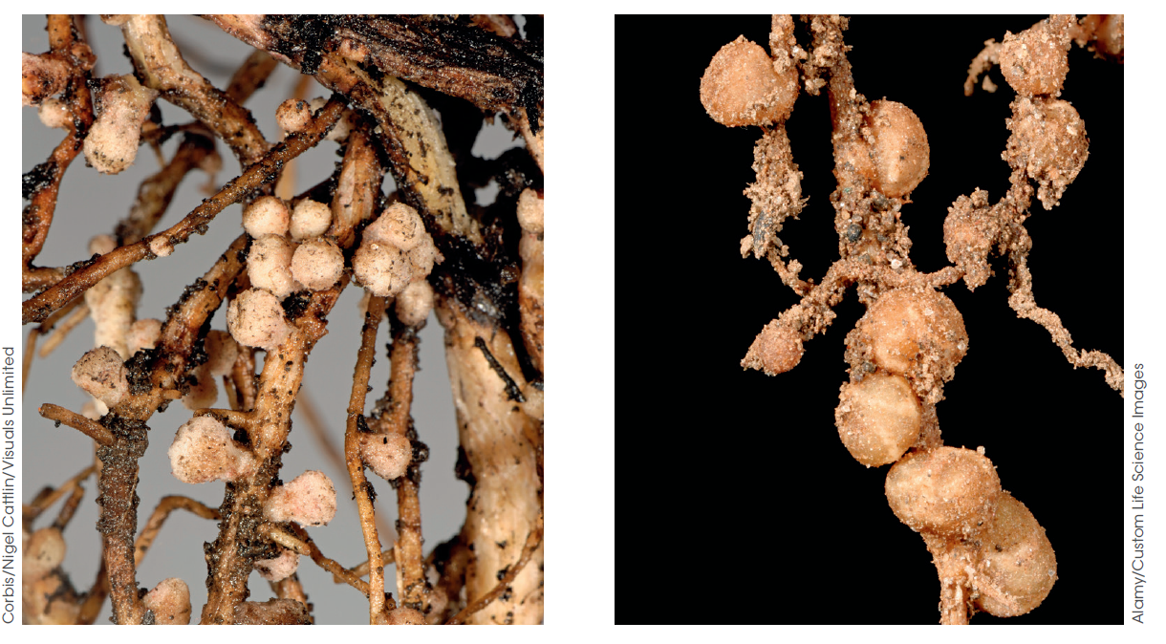
Nitrogen cycle and fixation
Full circle: How does matter get recycled?

Slide 26
Nitrifiers and denitrifiers
Full circle: How does matter get recycled?
Nitrifiers convert decaying material into nitrites
Nitrifying bacteria convert the ammonia released in urine and decaying faeces, dead plants and animals to nitrite ions (NO₂–). Other bacteria convert the nitrites to nitrates that, only then, can be absorbed by plants.
Denitrifiers convert nitrites into atmospheric nitrogen
Plants growing in waterlogged soils have a shortage of oxygen. Denitrifying bacteria convert nitrates in the soil to nitrites. This releases oxygen required for their metabolic processes.
How does nitrogen reach the ocean?
In the oceans, some of the available nitrogen (such as nitrate and ammonium compounds) is brought in by rain and the activities of nitrogen-fixing organisms.
Notes:
Some nitrogen descends beneath the upper 100 m of the surface beneath which photosynthetic organisms are absent. At depth, nitrogen compounds are unavailable to most organisms.

Slide 27
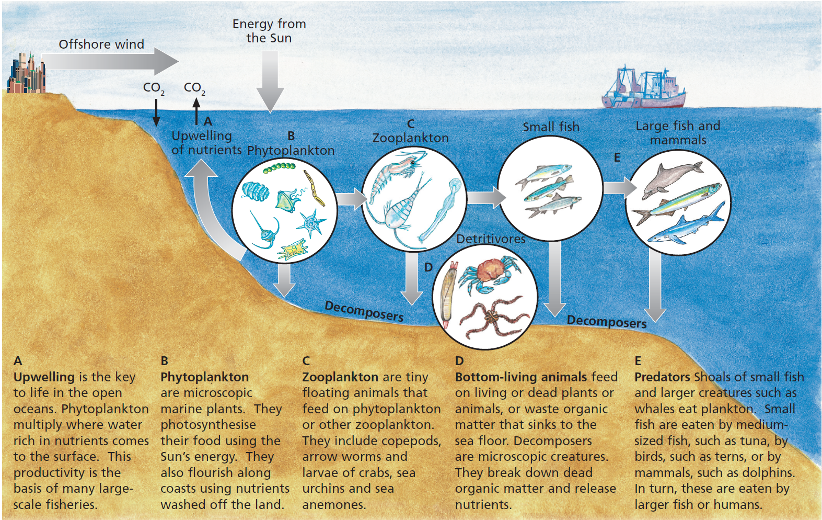
Nutrient cycle in the ocean
Full circle: How does matter get recycled?
Notes:
Reduced productivity in the oceans (i.e. reduced quantity of harvested seafood) has been attributed to both human impact and to changes in the natural ocean environment. Offshore, overfishing has had a catastrophic impact on the world’s stocks of most of the sought after fish including bluefin, orange roughy and Chilean bass. Scientific reports have estimated that industrial fishing has reduced fish stocks by 90%. In contrast, closer to the shore and in estuaries, powerful natural uprising currents bring nutrients to the surface. In the latter regions, plant and animal life is more abundant, contributing to the success of fishing industries.

Slide 28
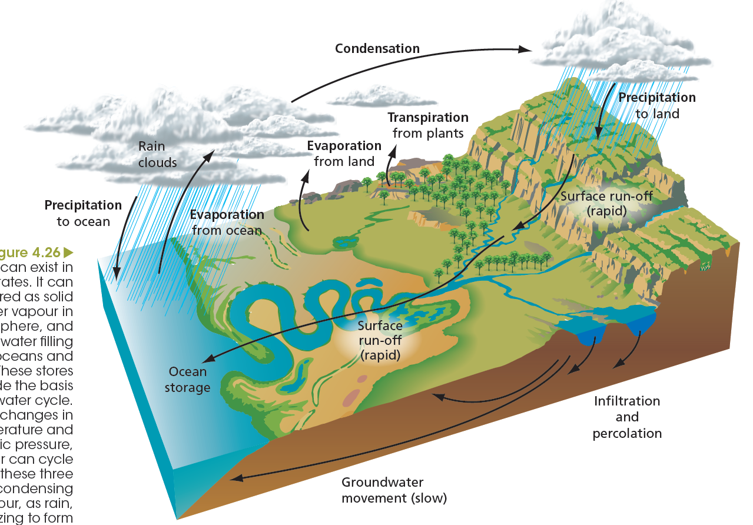

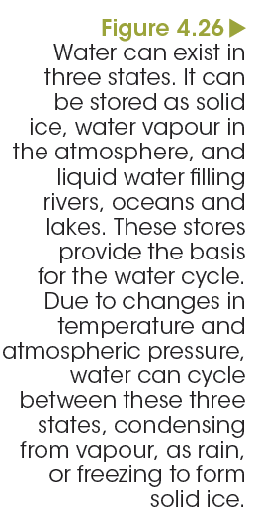
Water cycle
Full circle: How does matter get recycled?
Notes:
The water cycle is also known as the hydrological cycle and is driven by two energy sources:, solar energy and gravity.

Slide 29
Pesticides in the food chain
Biological magnification
In the 1950s the association between the use of pesticides for agricultural applications and the decline of raptor (birds of prey) populations was noticed.
Brown pelicans and peregrine falcons in Australia
Bald eagles and peregrine falcons in North America and Northern Europe.
Notes:
This process of amplifying the amount of substance is referred to as biological magnification. While the toxicity of these compounds may not affect organisms lower in the food chain, their effects at the top of the food chain can be disastrous.
The concentrations of non-biodegradable substances, such as dicholorodiphenyltrichloroethane (DDT) and mercury can increase to as they get passed on from one trophic level to the next along a food chain.

Slide 30
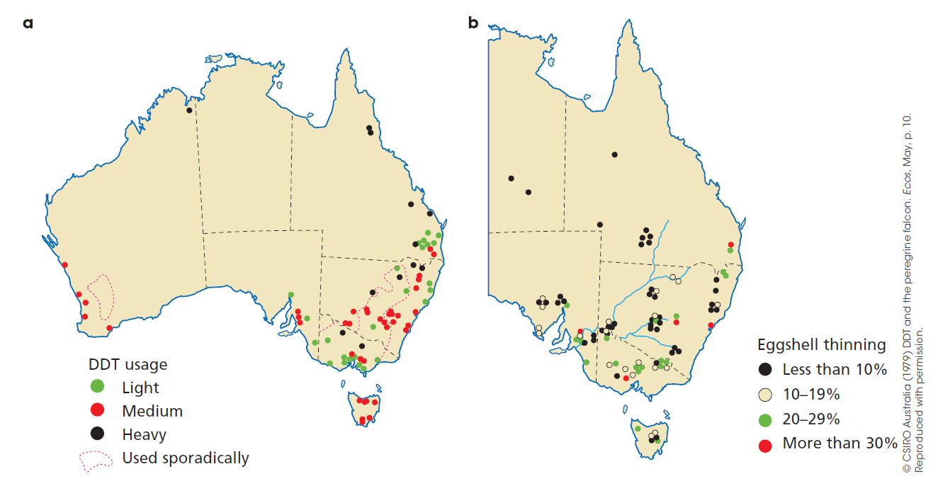
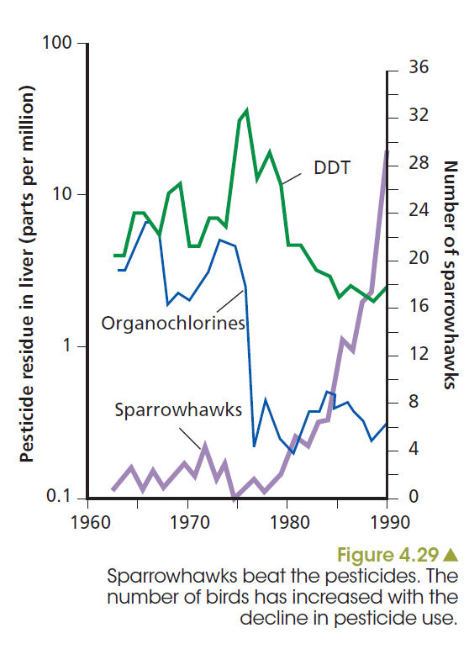
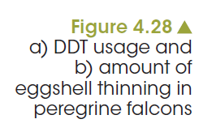
Pesticides in the food chain
Biological magnification
Notes:
Accumulation of other ‘industrial’ pollutants, such as the heavy metals including mercury and ‘natural’ toxic substances produced by some species of cyanobacteria, can cause problems along food chains. Organochlorines that have been eaten by birds are non-biodegradable because they cannot be metabolised (processed) by the liver into harmless substances. These substances are lipophilic, or fat-loving, and tend to accumulate in the fat of organisms that have taken in these chemicals. By applying the concept or idea of pyramids of biomass, you can see how it is that these chemicals become concentrated along food chains to such an extent that damage occurs to the top consumers.

